Slide 1
Push-OutputBinding ‘Anything’ Custom Bindings for Azure Functions
Emanuel Palm

Slide 2

Many thanks to our sponsors:

Slide 3

Emanuel Palm
Consultant at Advania – Knowledge Factory
Loves Code - .NET, PowerShell, C#
Blogs at pipe.how
Maker of modules
🧙‍♂️🍰☕🥏
Notes:
For those of you who are not amongst my soon-to-be 200 loyal Twitter followers

Slide 4
Platform Language
Azure Functions Versatile
Why?

Slide 5
Agenda
Quick introduction to Azure Functions
Less quick introduction to Azure Function Bindings
Azure WebJobs
Demo
Custom Output Binding – Discord – C#
Custom Trigger/Input Binding – RSS Feed – C#
Using the Custom Bindings – C# / PowerShell
Recap & Questions

Slide 6
about_AzureFunction
s
Bindings
Serverless code – Skip the (boring) infrastructure
Language-agnostic-ish
Bindings - Built-in Integrations
WebJobs SDK as a Service
🛬Input

Slide 7
about_Azure
FunctionBindings
🛫Output
Function Binding | Emoji Binding Support
Timer | ⚡
HTTP | ⚡🛬🚀
Storage Blob | ⚡🛬🚀
Storage Table | 🛬🚀
Storage Queue | ⚡🚀
Service Bus | ⚡🚀
Event Grid | ⚡🚀
Cosmos DB | ⚡🛬🚀
SendGrid | 🚀
Twilio | 🚀
Durable Functions | ✨
🚀Output
📚 Extension Bundles
❌ Custom Bindings
📄 function.json
🛬Input
⚡Trigger

Slide 8
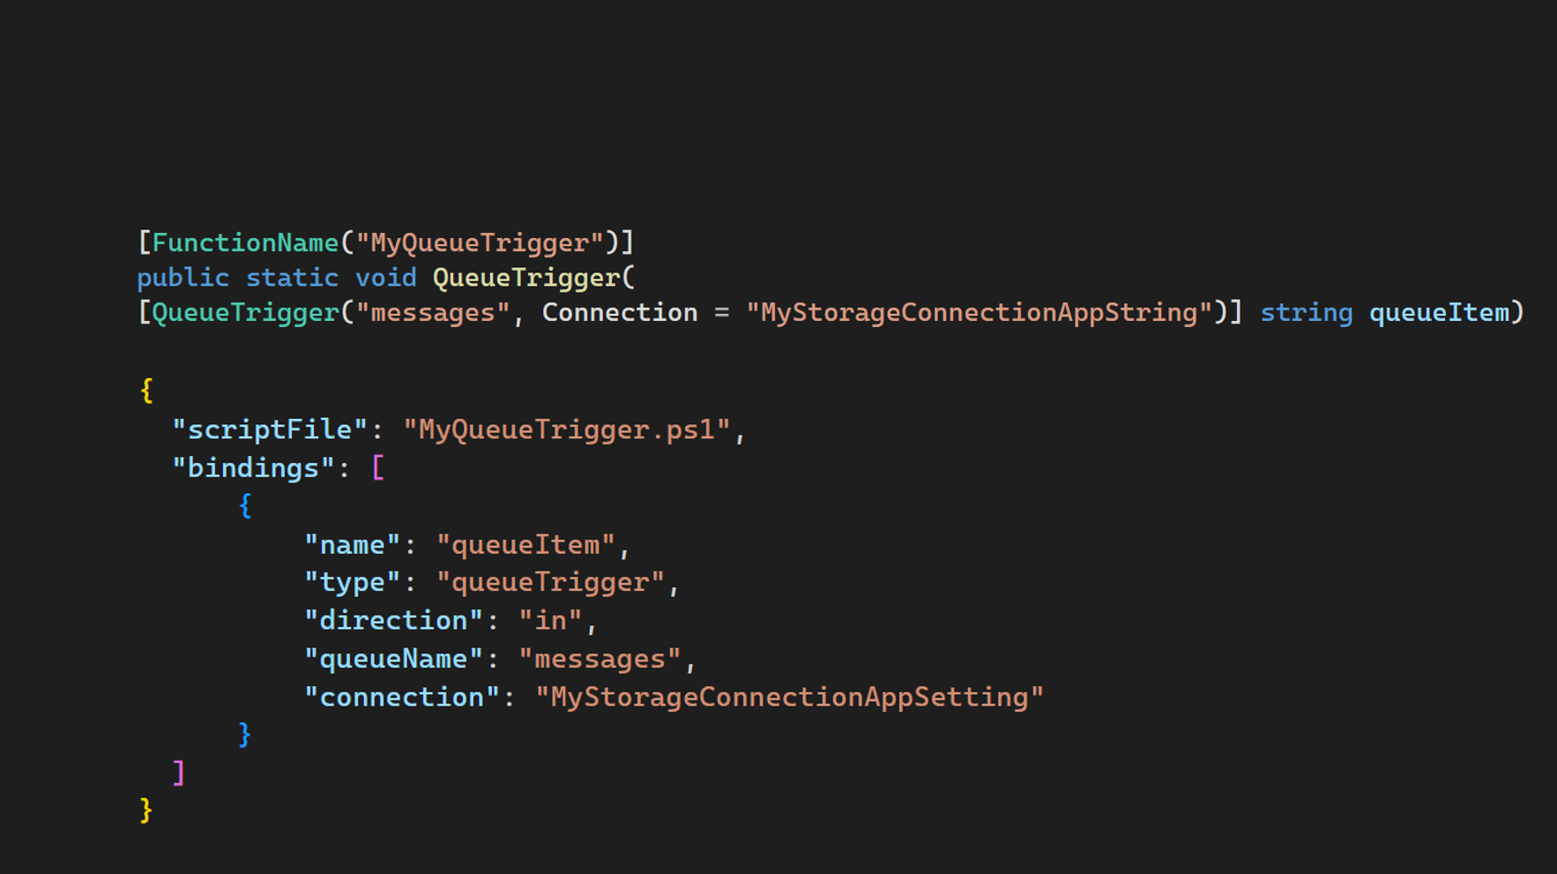







about_AzureFunctionBindings
MyQueueTrigger

Slide 9
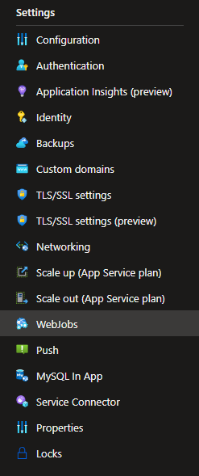
about_AzureWebJobs
App Service feature
Run scripts/programs in app context
Azure Functions 👍 WebJobs 👎
SDK to write Extensions – Bindings
NuGet Packages
“WebJobs SDK as a Service”

Slide 10
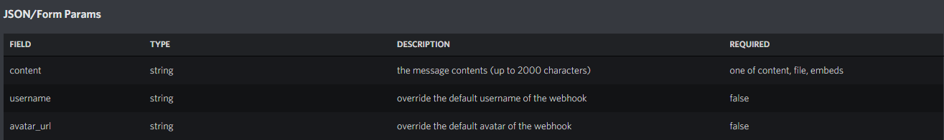
Discord Webhook API
$Params = @{
Uri = 'https://discord.com/api/webhooks/<id>/<token>'
Method = 'Post'
Body = @{
avatar_url = 'url-to-image'
username = 'PSConf Demo Bot'
content = 'Hello from PSConf!'
} | ConvertTo-Json
ContentType = 'application/json'
}
Invoke-RestMethod @Params
Notes:
$Params = @{
Uri = 'https://discord.com/api/webhooks/<id>/<token>'
Method = 'Post'
Body = @{
avatar_url = 'https://pbs.twimg.com/profile_images/1498991285809655811/0IwmQcfF_400x400.jpg'
username = 'PSConf Demo Bot'
content = 'Hello from PSConf!'
} | ConvertTo-Json
ContentType = 'application/json'
}
Invoke-RestMethod @Params

Slide 11



Discord Output Binding
[IWebJobsStartup] DiscordStartup.cs
[Attribute] DiscordBinding.cs
Configure Binding
string DiscordWebhookUrl
string DiscordUserName
string DiscordAvatarUrl
1
[IExtensionConfigProvider] DiscordExtensionConfigProvider.cs
2
[IAsyncCollector] DiscordAsyncCollector.cs
Bind Attribute to Collector
Post to Discord API

Slide 12
Creating Azure Function Bindings
New-Demo –Topic @(
‘WebJobs Extensions’
‘Azure Functions’
‘Custom Bindings’
‘PowerShell’
‘Trigger’
‘Discord’
‘Output’
‘RSS’
‘C#’
)
Notes:
21min

Slide 13
New-AzFuncBinding | How
Invoke-SessionWrapUp –Question @{
‘Why?’ = @(
‘Azure Functions’
‘Language flexibility’
)
‘Why not?’ = @(
‘Azure Functions’
‘App Service Plans’
‘Complexity’
‘Scaling’
‘PowerShell Modules’
‘Support’
)
}

